Slide 1
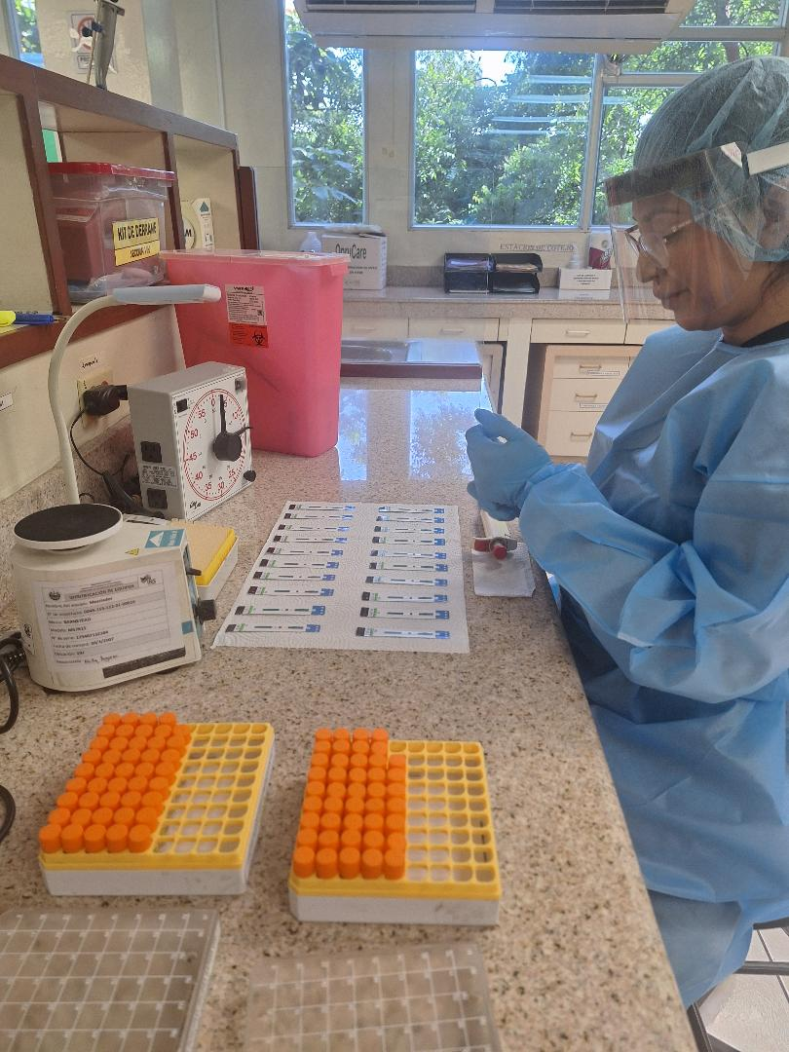

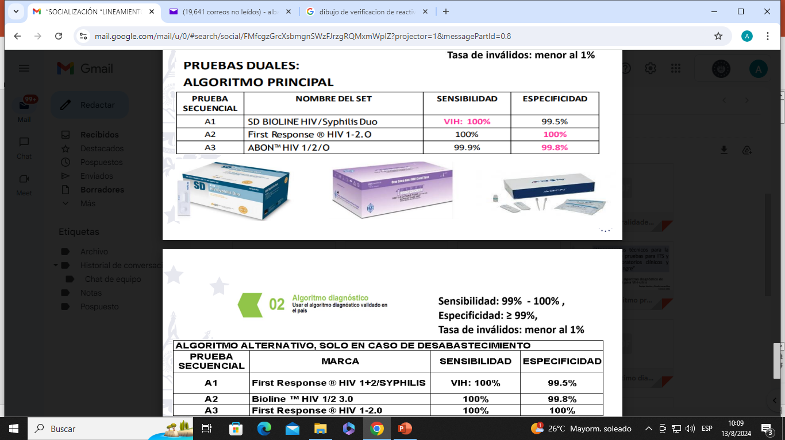
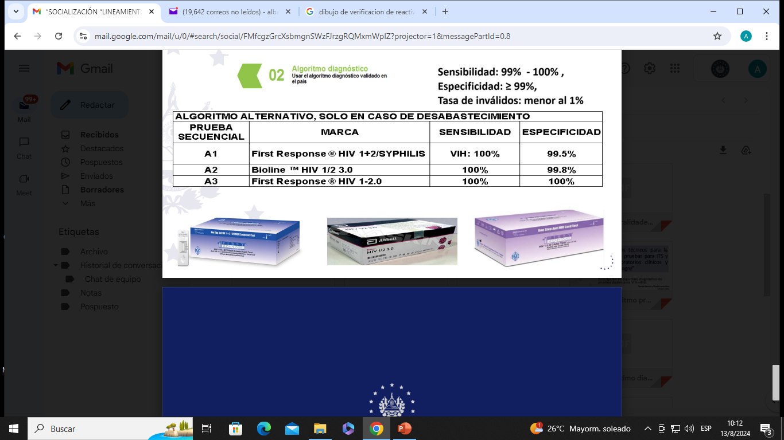
HOW TO MONITOR THE QUALITY OF A KIT
Licda. MSPS Raquel Peñate
LVSP/ LNSP/El Salvador

Slide 2



Fifth pillar of RTCQII
Strengthen national capacity for surveillance of kit lots after their marketing.
Lot testing and post-market surveillance
Focused on improving the quality and performance of the tests, carried out on each lot acquired nationally

Slide 3
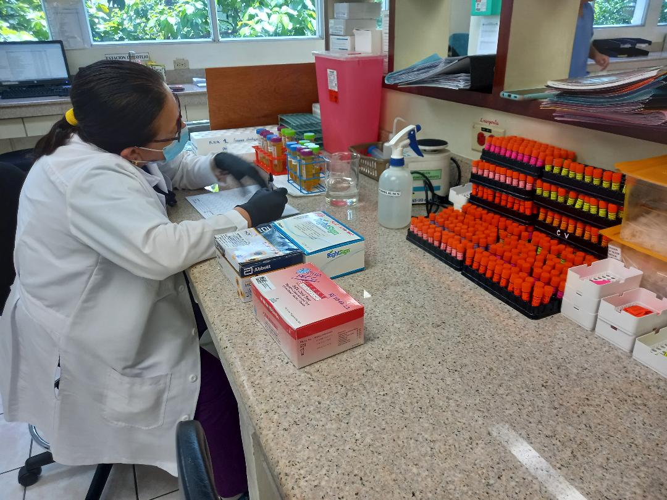
FUNCTIONS OF THE PUBLIC HEALTH SURVEILLANCE LABORATORY
Carry out verifications of the reagents for the diagnosis of STIs and HIV
Following the provisions of the verification protocols in support of the STI/HIV program unit.
Provide a technical opinion on the operation of the Lots of rapid tests acquired (post-sale or pre-distribution)
HIV, syphilis, Hepatitis B and C, among others, in support of the STI/HIV program.
http://asp.salud.gob.sv/regulacion/pdf/lineamientos/lineamientostecnicosparalaejecuciondepruebasparaITSyVIHenlaboratoriosclinicosybancosdesangre-Acuerdo-2154_v1.pdf

Slide 4

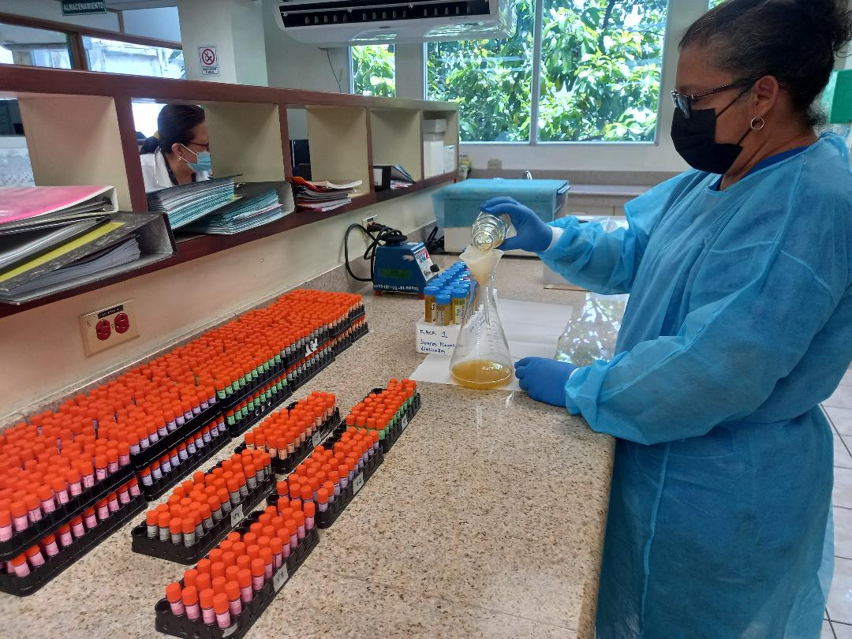


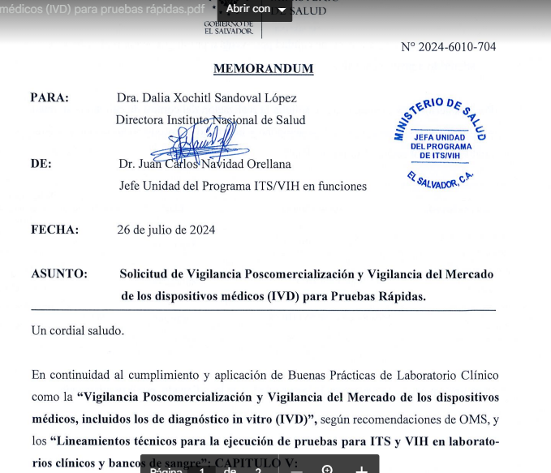

METHODOLOGY
Carried out in each purchased rapid HIV and STI tests lot nationwide
Minimum of 25 or 50 free tests provided by each supplier, included as a requirement in the bidding rules
Carried out to verify the performance characteristics of the tests
The product to be distributed and used for diagnosis in the national laboratory network must comply Quality control
All requests
Must be channeled through the National STI/HIV program.
Any reagent that does not comply with this Pre-distribution quality control requirement
Cannot be distributed or used at the different local levels, since this puts at risk the proper functioning of the lots used for the diagnosis and the quality of the results. that is provided in the establishments.

Slide 5


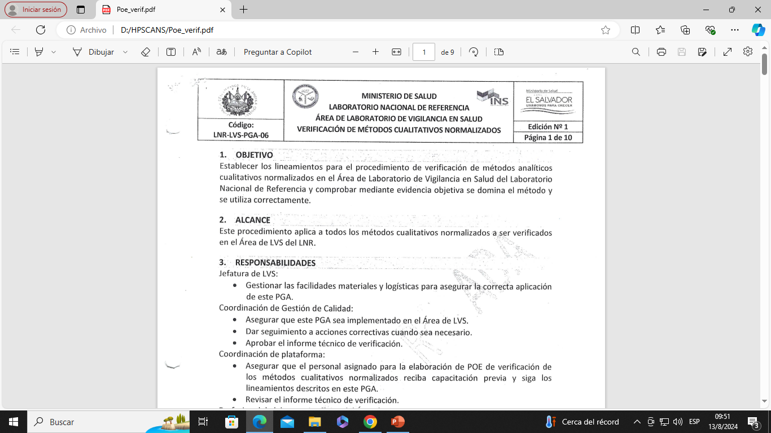
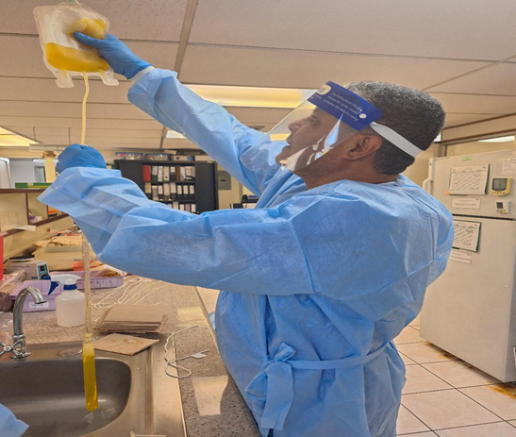
TECHNICAL VERIFICATIONS AND OPINIONS OF IVD REAGENTS
VERIFICATION
TECHNICAL OPINIONS
A verification SOP is used under CLSI EP12-A2 regulations and ISO 15189:2012 Salvadoran technical standard for clinical laboratories
They are carried out to control the quality of lots of reagents already verified before use, with a minimum of 25 tests.
When it is for the first time, before incorporating it into the standardized list of tests, the verifications are carried out with 100 samples, 50 negative and 50 positive with characterized panels.

Slide 6
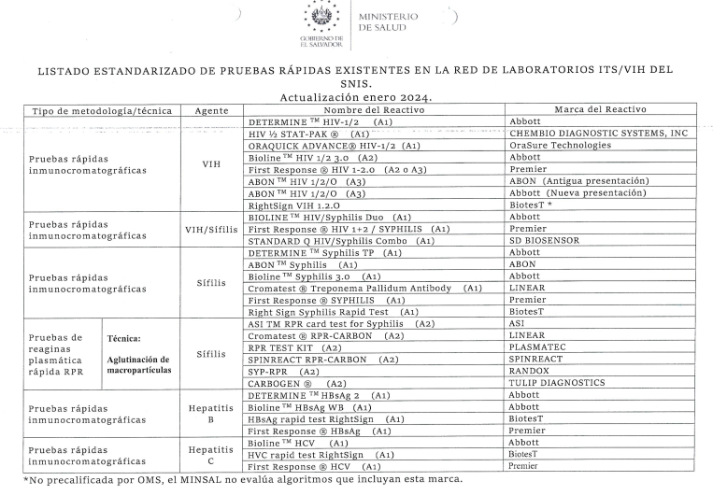
STANDARDIZED LIST OF TESTS AS OF JUNE 2024 AT THE NATIONAL LEVEL
http://asp.salud.gob.sv/regulacion/pdf/lineamientos/lineamientostecnicosparalaejecuciondepruebasparaITSyVI Henlaboratoriosclinicosybancosdesangre-Acuerdo-2154_v1.pdf

Slide 8



LESSONS LEARNED
Monitor at the country level (SNIS) the quality of reagent to be used, this includes all MINSAL institutions that make purchases with their budget.
Reduce the discordance of results obtained through reagent verification processes.
Evaluate the performance of the reagents used.

Slide 9
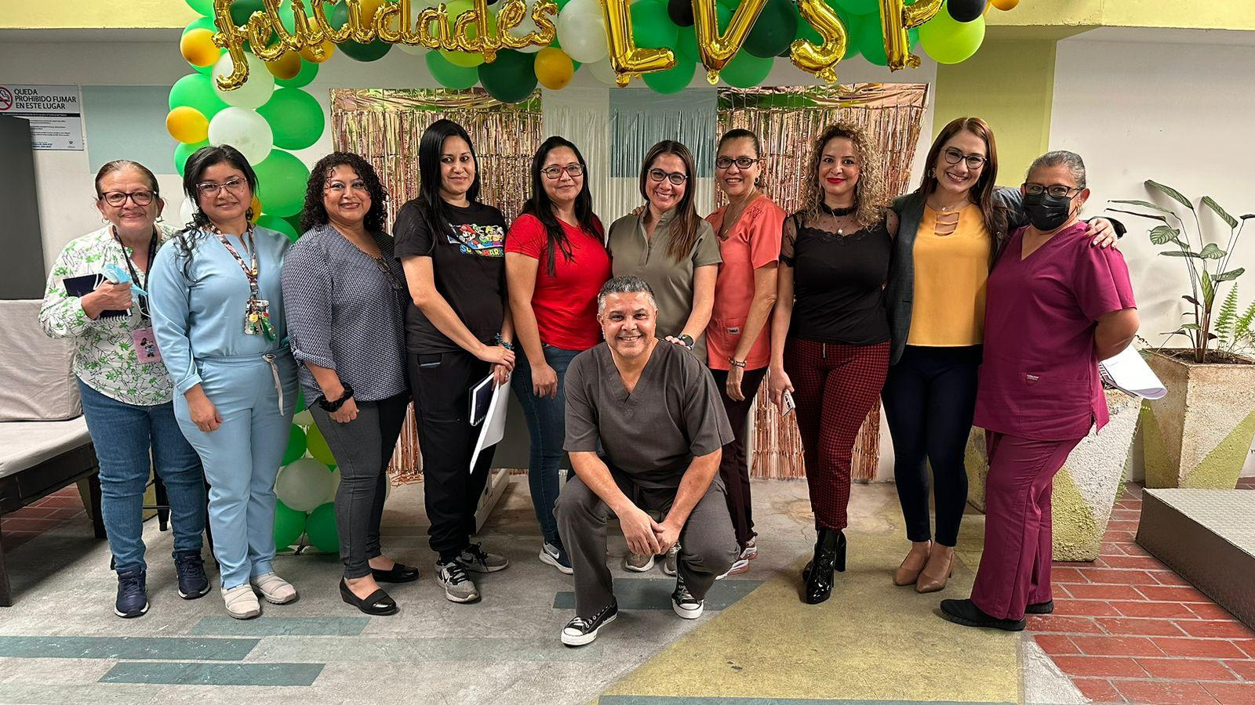



Coordinación inmunohematología

